Slide 1

Pack Meeting Pack 232
December 10th 2019

Slide 2
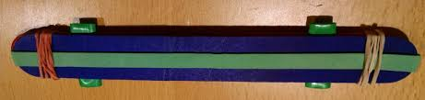
Making a Noise Maker
SUPPLIES
2 craft sticks
1 thick rubber band
2 thin rubber bands
2 straw pieces
Wrap the thick rubber band along the long edge of one of the craft sticks
Place the two straw pieces on top of the thick rubber band perpendicular to the craft stick (see picture above)
Put the other craft stick on top of the straw pieces and make a craft stick “sandwich”
Wrap each end of the craft sticks with the thin rubber bands
Blow into the middle of the Noise Maker!!!!

Slide 3
Pack Meeting – Dec. 10th
Gathering – Make a Noise Maker
Opening – Pledge/Oath/Law/Outdoor Code
Knot Tying Program / Games in Gym
Recognition - Awards
Snacks
Pinewood Derby Kits
Announcements
Cubmaster’s Minute

Slide 4
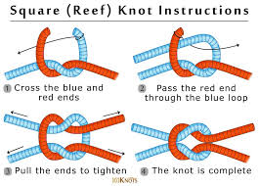
Tied up in Knots!! Square Knot
Hold an end of the rope in each hand.
Pass the right end over and under the rope in your left hand.
Pass the rope end now in your left hand over and under the one now in your right.
Tighten the knot by pulling both running ends at the same time.

Slide 5
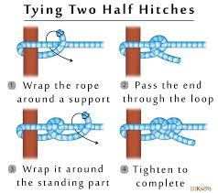
Tied up in Knots!! Two Half Hitches Knot
Pass the end of your rope around a post
Bring the end over the standing part of the rope
Pass the end through the eye of the loop you just formed
Pull it tight to complete a half hitch
Take the end of the rope over the standing part (again)
Tie another half hitch
Pull it tight

Slide 6
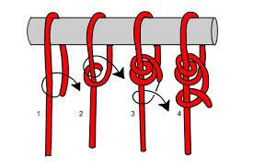
Tied up in Knots!! Taut Line Hitch Knot
Pass the end of your rope around a post
Bring the end over the standing part of the rope
Pass the end through the eye of the loop you just formed twice
Take the end of the rope over the standing part (again)
Tie a half hitch
Pull it tight

Slide 7
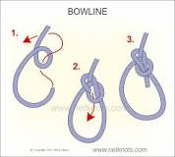
Tied up in Knots!! Bowline Knot
Lay the rope across your left hand with the free end hanging down. ...
Bring the free end up to and pass through the eye from the under side (the rabbit comes out of the hole).
Wrap the line around the standing line and back down through the loop (around the tree and back down the hole).

Slide 8
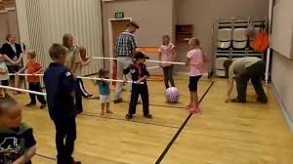
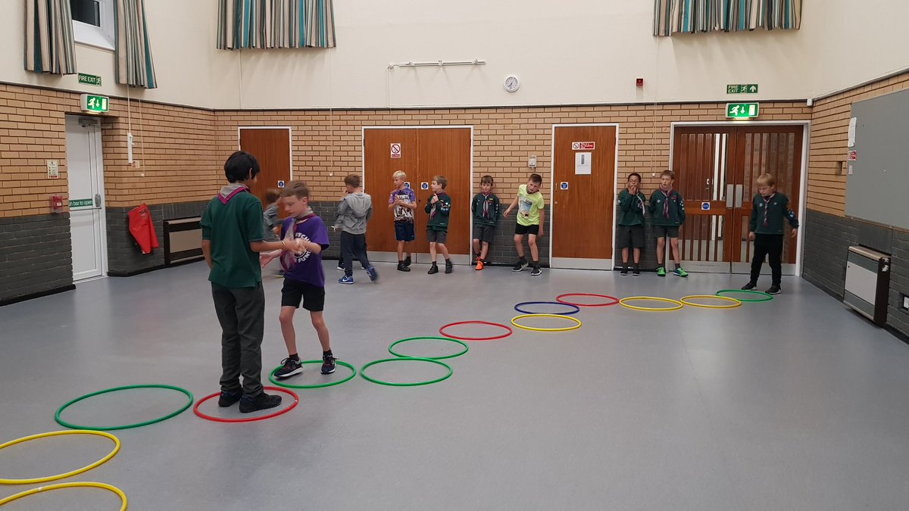
Games in the Gymnasium

Slide 9
Awards and Den Reports

Slide 10
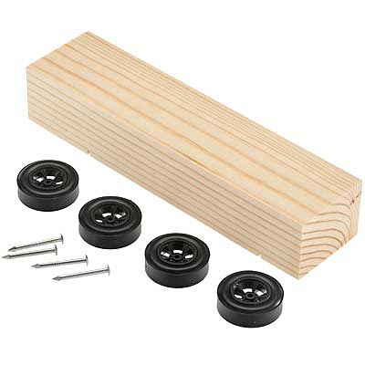
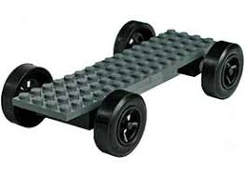
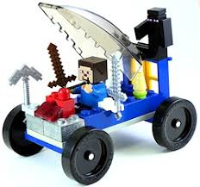
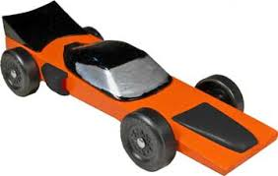
Pinewood Derby Sat. March 7 at Town Hall (9am)
Tigers – Arrow of Light
Lions

Slide 11

Scouting for Food Coordinator
Blue & Gold Picnic Coordinator
Pinewood Derby Team
Pack 232 t-shirt Coordinator
Membership Coordinator (social media expertise is a plus)

Slide 12
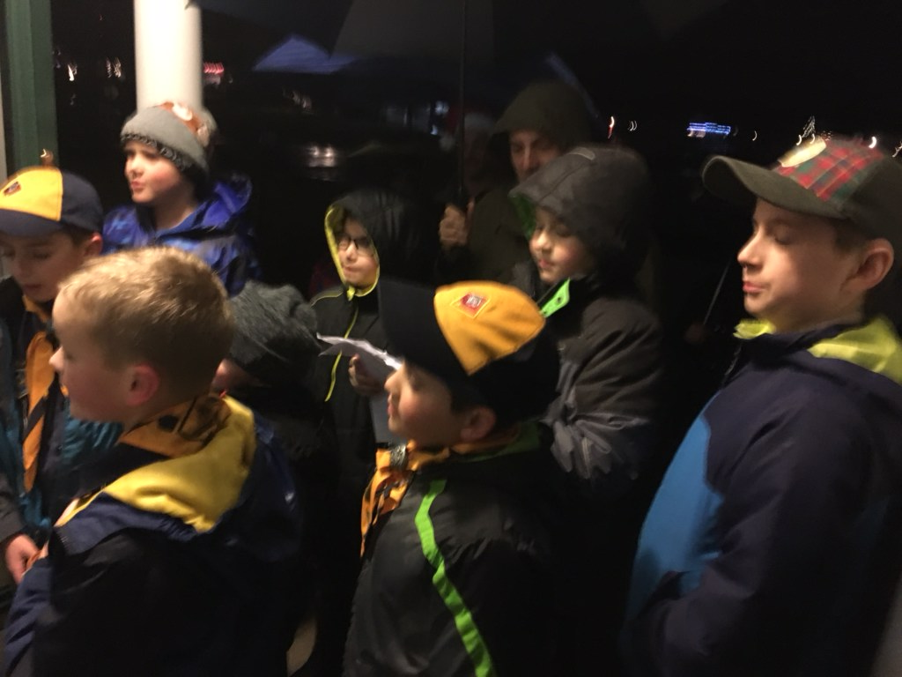
Caroling for RMH
Location = 5 Brookhaven Lane
When = Tuesday, December 17 at 6pm
Hot Chocolate After Caroling

Slide 13
Other Pack Events
Indoor Rock Climbing = January
Bethlehem Cub Scout Winter Carnival = Jan/Feb
Winter HEATED CABIN Camping = 2/07 – 2/09 (only 14 spots left!) – BSA Medical Forms and Activity Consent Forms Needed. Pay Mr. McWilliam by check.
Tubing = February
Pack Pinewood Derby = 3/07
Howe Caverns = 3/28
Visit a Blacksmith Forge = April
Cub Scout Day at Rotary = 5/02
USS Slater Sleepover = 5/08 – 5/09
Spring Hike = 5/17
Summer Resident Camp at Rotary = 8/02 – 8/06

Slide 14
STEM Day Camp Registration is Open!!!
For Wolves (2nd Grade) - Arrow of Lights (5th Grade).
Teaching problem solving, programming, team building, and much more!
Build your own computer! and take it home!
When = February 18 – 21
Where = Shaker High School (445 Watervliet Shaker Road, Latham)
Cost = $225

Slide 15
Next Pack Meeting Tuesday, January 21 (6:30PM-8PM)
Wolves (2nd Grade) Den is the Host
Gathering – Building Ice Fishing Tip Ups
Program – Ice Fishing Demo and Safety
Game – M&M Separation Anxiety
Awards
Snacks

Slide 16
Cubmaster’s Minute
How often do you think of what your parents want from you? Do you know what is the best gift you can give them?
Parents want most of all that you will do your best to make them proud of you. Now you do not have to become famous or even get top grades in school to make them proud of you.
What they want is for you to become the best person you can be. There is no better way to do that than by living up to the Scout Oath and Law. That is a gift you can give them right now and all the time, and it is a gift they will always cherish above all others.

